Slide 1


Slide 2
Presented By: Ashwini A. Patil
submission Date:28/08/2022

Slide 3
Project Name:
Micro Credit Loan Defaulter

Slide 4


Slide 5

Introduction
Problem Statement:
A Microfinance Institution (MFI) is an organization that offers financial services to low income populations. MFS becomes very useful when targeting especially the unbanked poor families living in remote areas with not much sources of income. The Microfinance services (MFS) provided by MFI are Group Loans, Agricultural Loans, Individual Business Loans and so on. Many microfinance institutions (MFI), experts and donors are supporting the idea of using mobile financial services (MFS) which they feel are more convenient and efficient, and cost saving, than the traditional high-touch model used since long for the purpose of delivering microfinance services. Though, the MFI industry is primarily focusing on low income families and are very useful in such areas, the implementation of MFS has been uneven with both significant challenges and successes.

Slide 6

Exercise
Build a model which can be used to predict in terms of a probability for each loan transaction, whether the customer will be paying back the loaned amount within 5 days of insurance of loan.
In this case, Label ‘1’ indicates that the loan has been paid i.e. Non- defaulter, while, Label ‘0’ indicates that the loan has not been paid i.e. defaulter.

Slide 7
Points to remember
There are no null values in the dataset.
There may be some customers with no loan history.
The dataset is imbalanced. Label ‘1’ has approximately 87.5 percent records, while, label ‘0’ has approximately 12.5 percent records.
For some features, there may be values which might not be realistic. You may have to observe them and treat them with a suitable explanation.
You might come across outliers in some features which you need to handle as per your understanding. Keep in mind that data is expensive and we cannot lose more than 7-8 percent of the total data.

Slide 8
Introduction
Today, microfinance is widely accepted as a poverty-reduction tool, representing $70 billion in outstanding loans and a global outreach of 200 million clients. We are working with one such client that is in Telecom Industry. They are a fixed wireless telecommunications network provider. They have launched various products and have developed its business and organization based on the budget operator model, offering better products at Lower Prices to all value conscious customers through a strategy of disruptive innovation that focuses on the subscriber. They understand the importance of communication and how it affects a person’s life, thus, focusing on providing their services and products to low income families and poor customers that can help them in the need of hour. They are collaborating with an MFI to provide micro-credit on mobile balances to be paid back in 5 days. The Consumer is believed to be defaulter if he deviates from the path of paying back the loaned amount within the time duration of 5 days. For the loan amount of 5 (in Indonesian Rupiah), payback amount should be 6 (in Indonesian Rupiah), while, for the loan amount of 10 (in Indonesian Rupiah), the payback amount should be 12 (in Indonesian Rupiah).

Slide 9
Project Goals
Analytical Problem Framing
Exploratory Data Analysis (EDA)
Visualizations
Data Pre-Processing on train and test datasets
Model/s Development and Evaluation
Performing hyper parameter tuning, saving the best model and predicting the label
Conclusion and future work discussion

Slide 10
Exploratory Data Analysis
First I have imported the necessary libraries and loaded the entire dataset in our Jupyter Notebook and renamed the project file from untitled.
Then I checked the shape of our dataset and found that we have a total of 2,09,593 rows and 37 different columns.
We don’t have any null values or missing values present in our dataset.
There was only one duplicate row/record in our dataset and I removed it from our dataset.
By checking the data types I came to know that our data set consists of columns have float, integer and object data type values.
Shape : 2,09,593 rows and 37 columns
No null values present
Only one duplicate row/record found
Datatypes of float, integer and object are in dataset

Slide 11
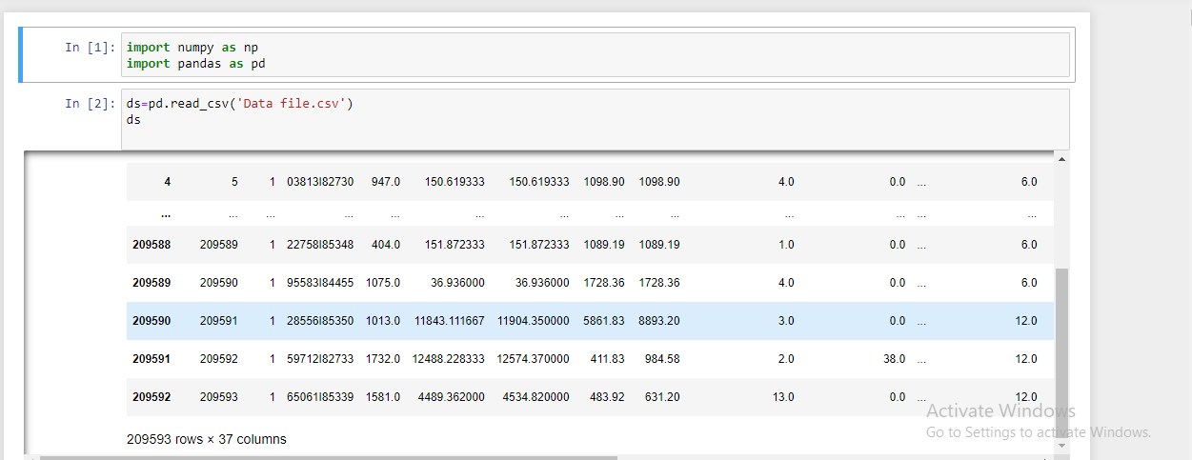
Importing all the necessary libraries and loading the data set

Slide 12
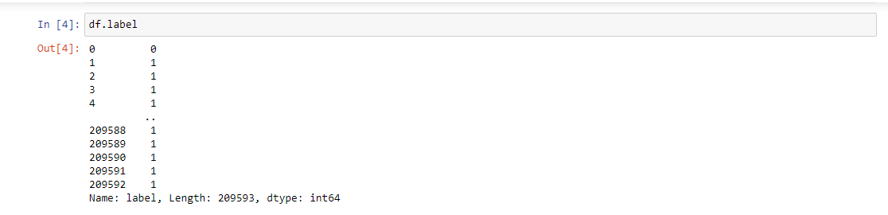
Now we have identified the problem looking at the data set, hence from the below picture you can clearly see that the problem is of logistic regression problem and label is dependent variable target

Slide 13
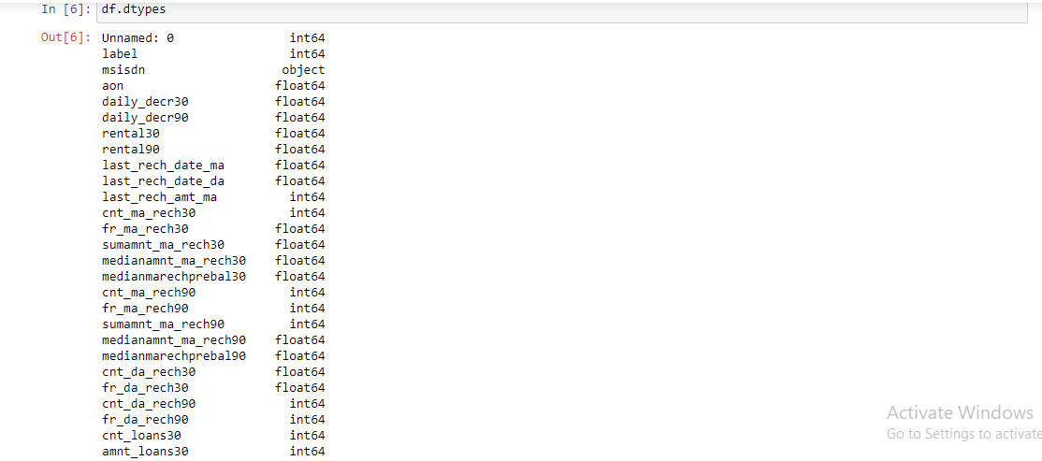
Below picture is showing the Data type

Slide 14
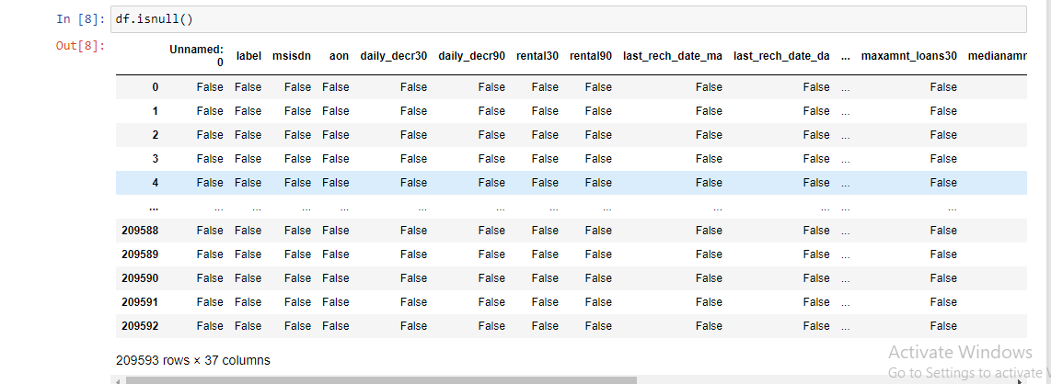
We have checked the Null values in the data set using is null function

Slide 15
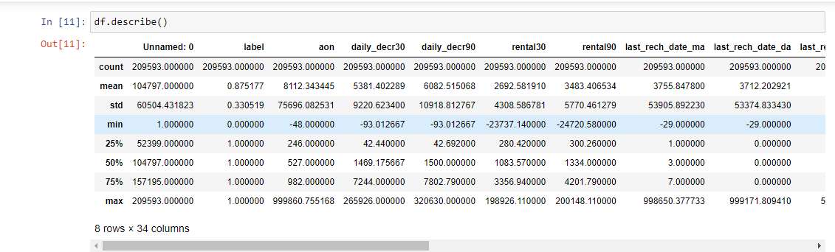
Below is Description of the Data set

Slide 16
Key observations
1 we can see the huge difference between the range of data of all the columns.
2 we can see the huge difference in 50% percentile and mean .
3 There is a large difference in 75% percentile, which shows the extreme outliers present in many columns like
aon,daily_decr30,daily_decr90 etc.
4 There is a small difference in 75% percentile in Unnamed column which shows that their are no outliers
-->By observing the above points we can see that their are extreme outliers in the data,due to this
skewness is also present ,and their is huge difference between the range of each column.

Slide 17
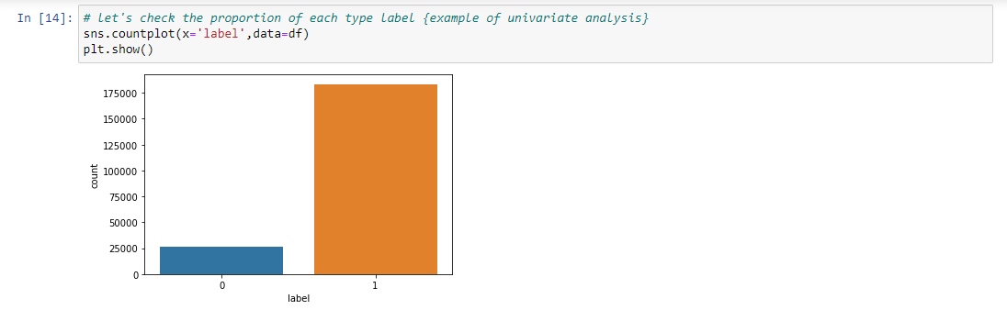
Checking the imbalance in our data set so the below picture resemble the imbalance in the data set

Slide 18
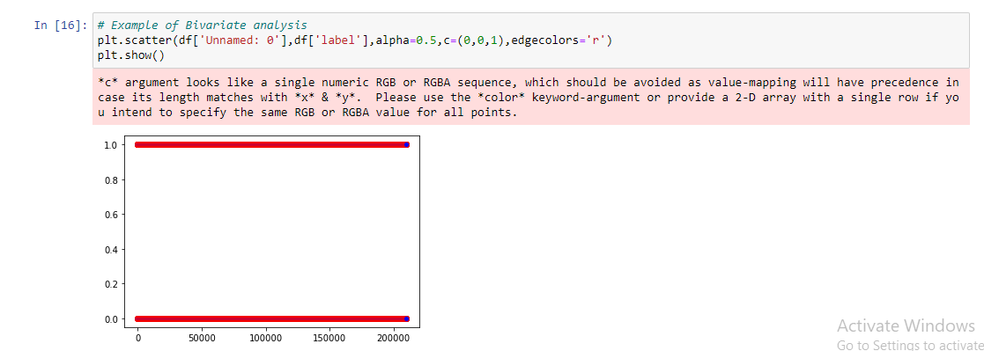
Below is the example of Bivariate analysis we have plotted scatter plot

Slide 19
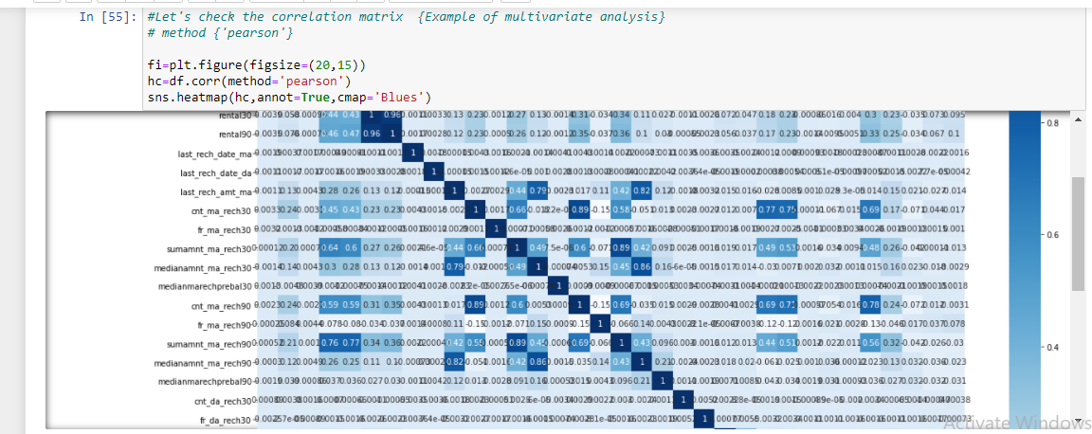
Example of Multivariate analysis Here we will check the co relation matrics by plotting heat map

Slide 20
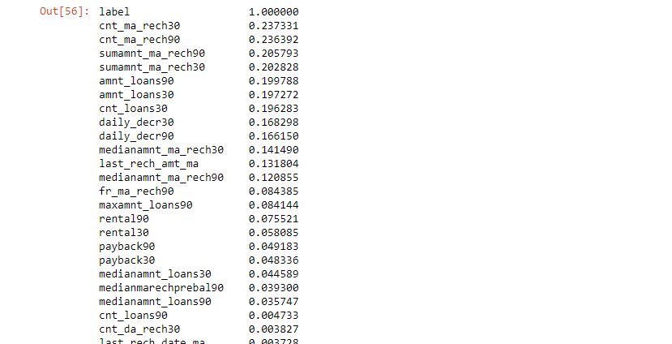
hc['label'].sort_values(ascending=False)

Slide 21
Observations:
Now we can clearly identify the correlation of independent variable with target variable "label" .The variables who has values less than 0.01
correlation value(very week relationship).

Slide 22
Label Encoding
After label Encoding the column is totally converted into the integer format.
So we have to apply Label encoding on the whole dataset, because some values seems are not realistic ,so just to deal with them.
we apply Label encoding on the whole dataset.

Slide 23
Conclusion
Key Findings and Conclusions of the Study: From the final model MFI can find if a person will return money or not and should a MFI provide a load to that person or not judging from the various features taken into consideration.
Learning Outcomes of the Study in respect of Data Science: I built multiple classification models and did not rely on one single model for getting better accuracy and using cross validation comparison I ensured that the model does not fall into overfitting and underfitting issues. I picked the best one and performed hyper parameter tuning on it to enhance the scores.

Slide 24
Limitations of this work and Scope for Future Work
Limitation is it will only work for this particular use case and will need to be modified if tried to be utilized on a different scenario but on a similar scale.
Scope is that we can use it in companies to find whether we should provide loan to a person or not and we can also make prediction about a person buying an expensive service on the basis of there personal details that we have in this dataset like number of times data account got recharged in last 30 days and daily amount spent from main account, averaged over last 30 days (in Indonesian Rupiah) so even a marketing company can also use this.

Slide 25


